Slide 1
Group 1 10_24_25
Great Travel Agency

Slide 2
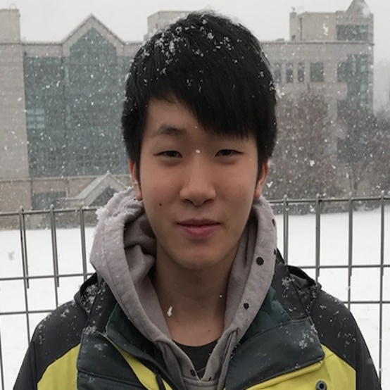


Our Members :
(10) 陸家俊
(24) 黃嘉輝
(25) 羅佩明

Slide 3
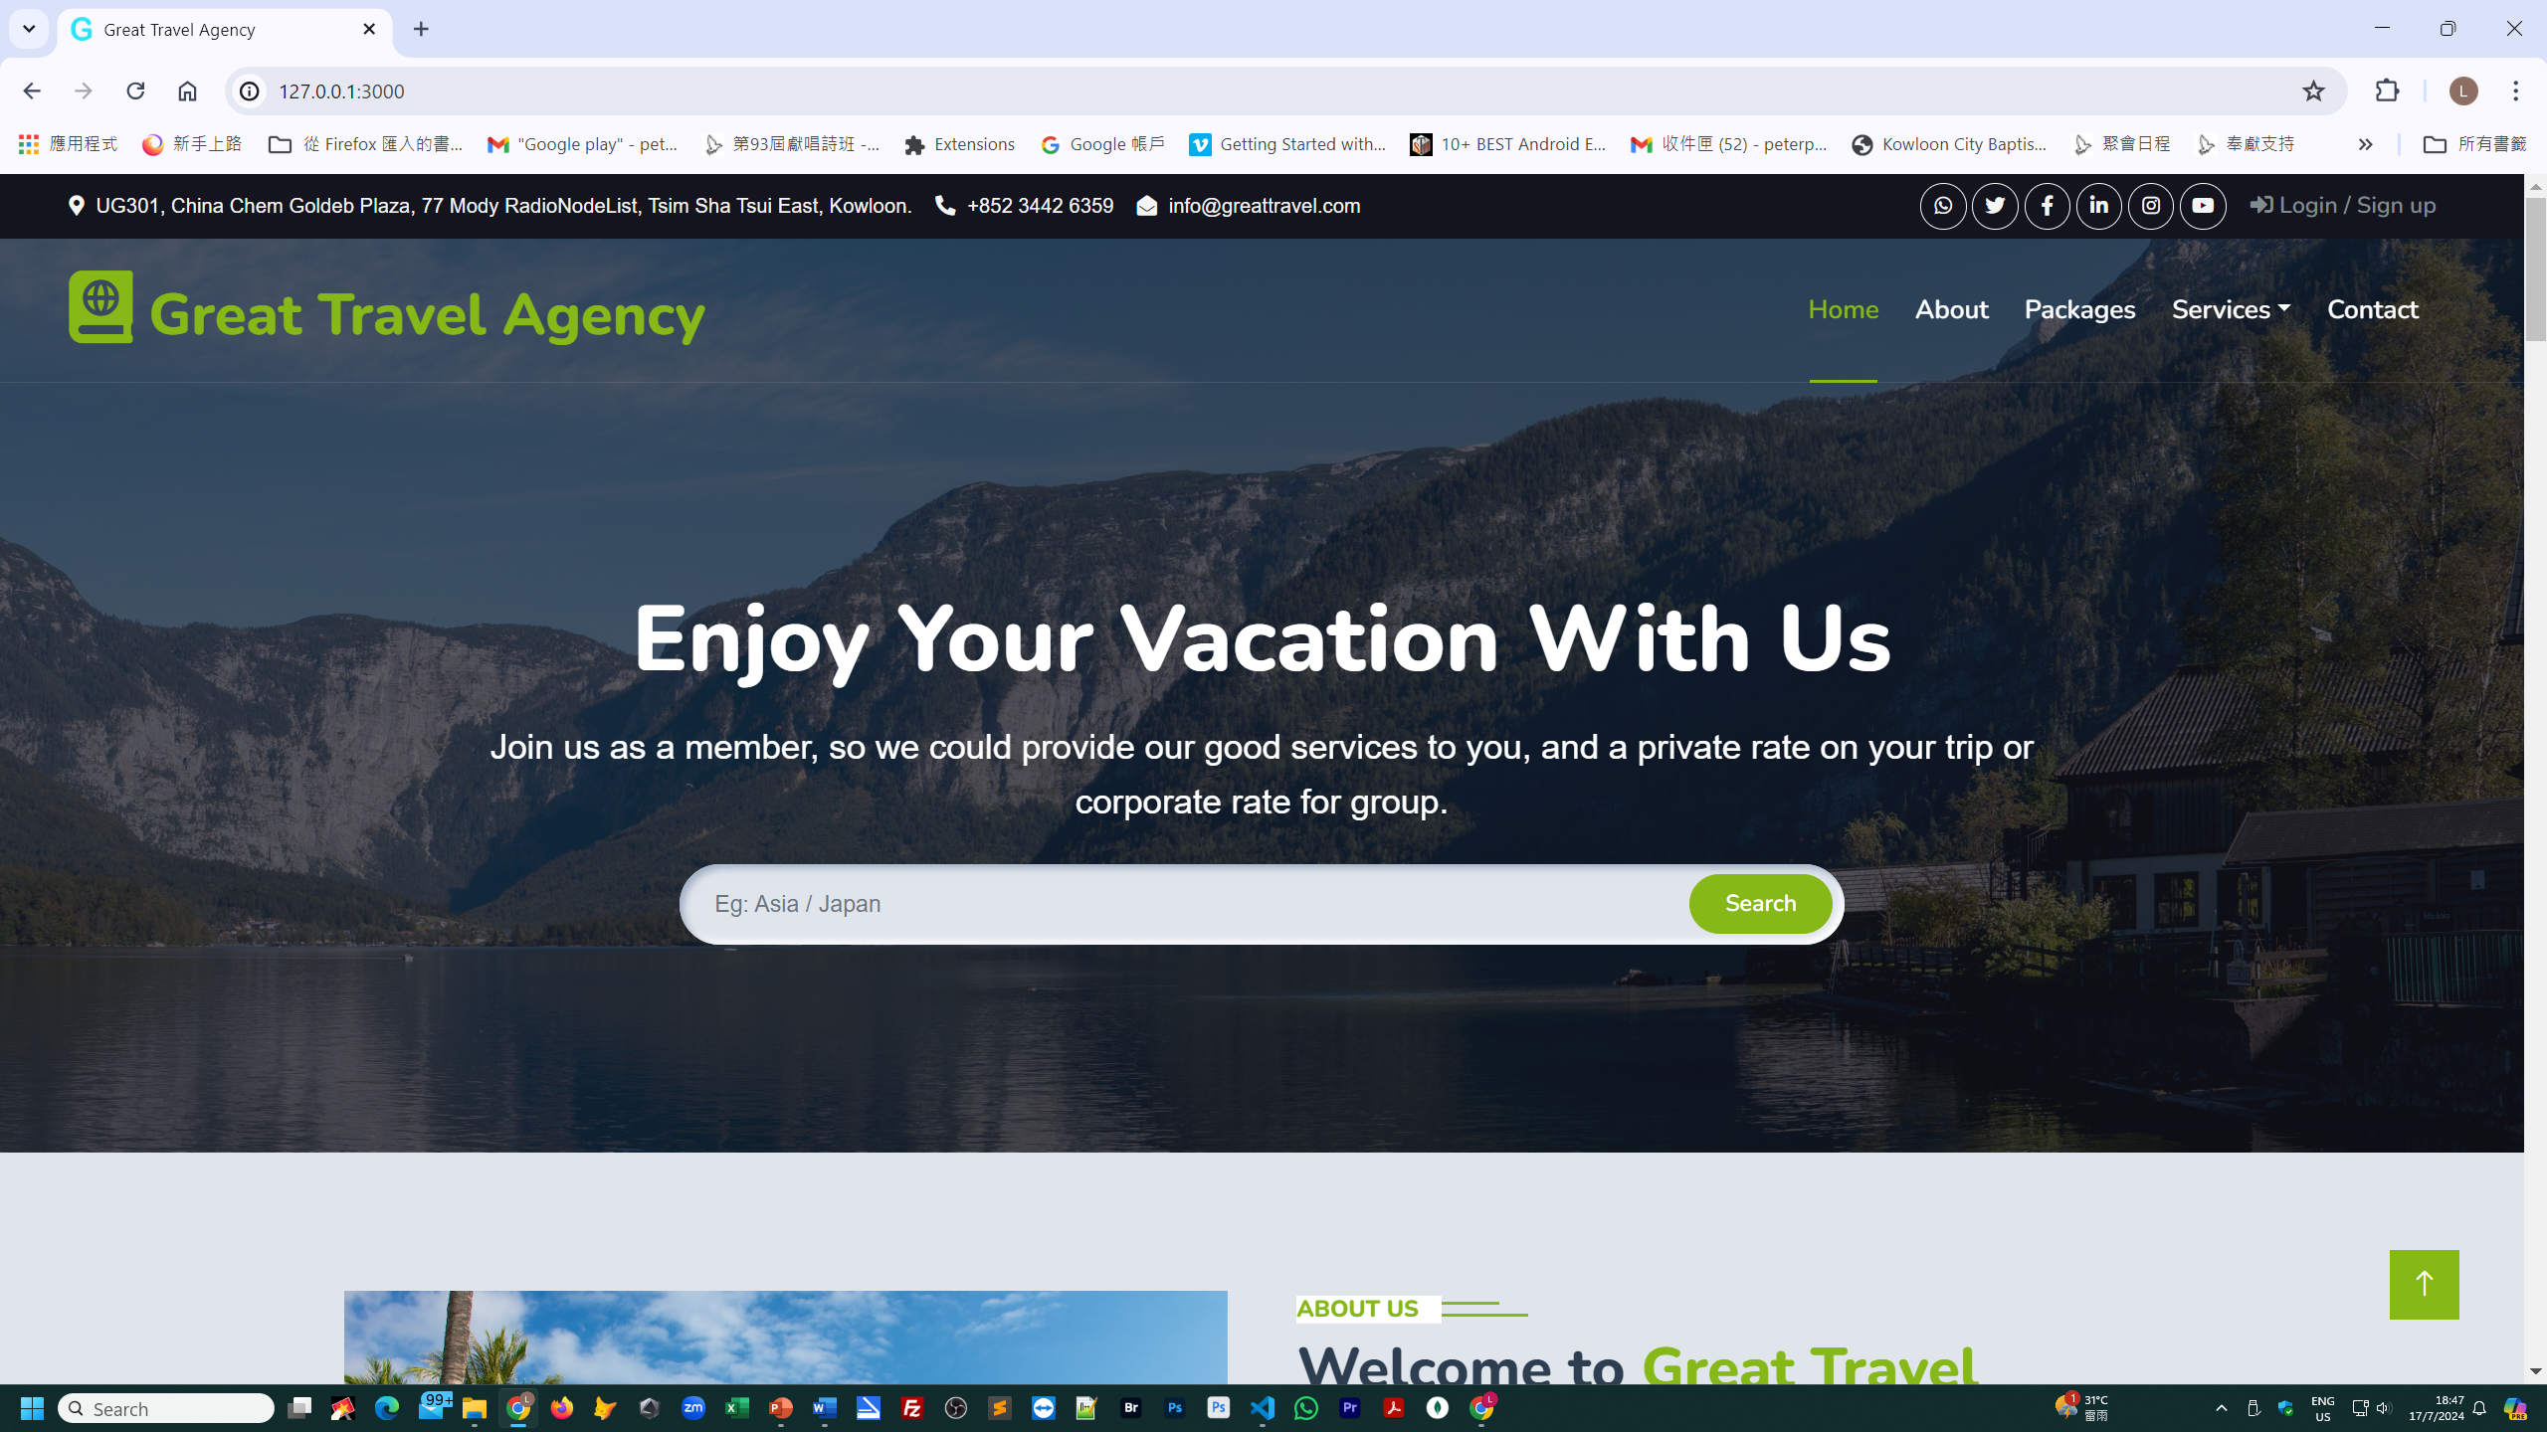

Slide 4







Great Travel Agency
- Web site base colour
#86B817
- Google fonts (Nunito, Sans-serif, Heebo )
- Icon Font (//cdnjs.cloudflare.com)
- HTML , CSS , Javascript ,
Bootstrap , Nodejs , API ,
MongoDB , Multer。

Slide 5
Great Travel Agency
Home (Landing Page)
Login / Sign up
Member
About
Packages
Services
Contact
My Profile
Destination
Testimonial
Privacy Policy
Booking
Terms & Condition
Travel Guide
Testimonial
FAQs & Help
Frontend

Slide 6
Web Server
├── body-parser@1.20.2
├── cookie-parser@1.4.6
├── debug@2.6.9
├── ejs@3.1.10
├── express-session@1.18.0
├── express@4.19.2
├── http-errors@1.6.3
├── jsonschema@1.4.1
├── mongodb@6.7.0
├── mongoose@8.4.3
├── morgan@1.9.1
├── multer@1.4.5-lts.1
└── nodemon@3.1.4

Slide 7
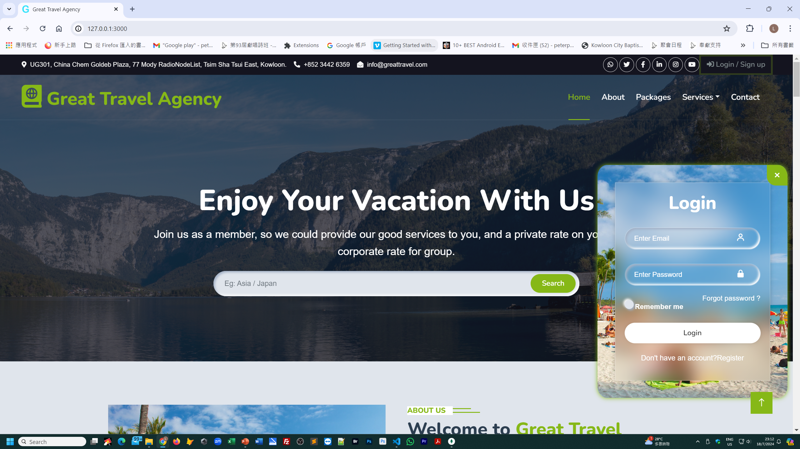

Slide 8
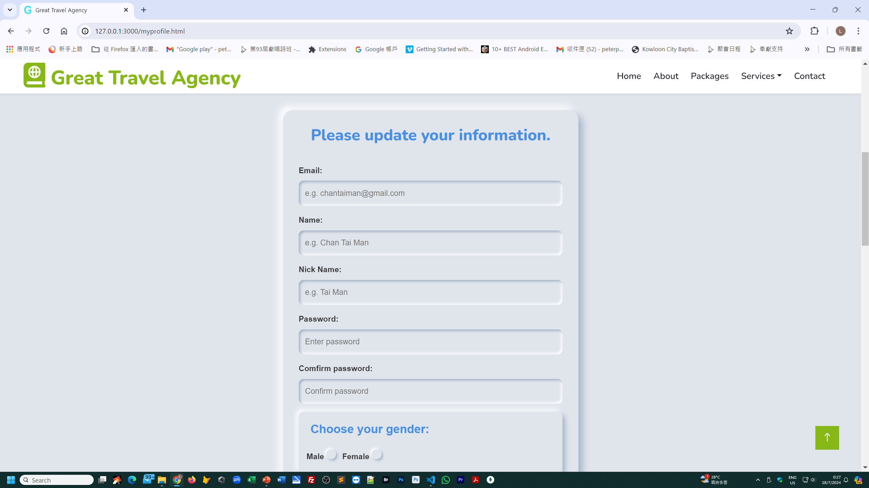

Slide 9
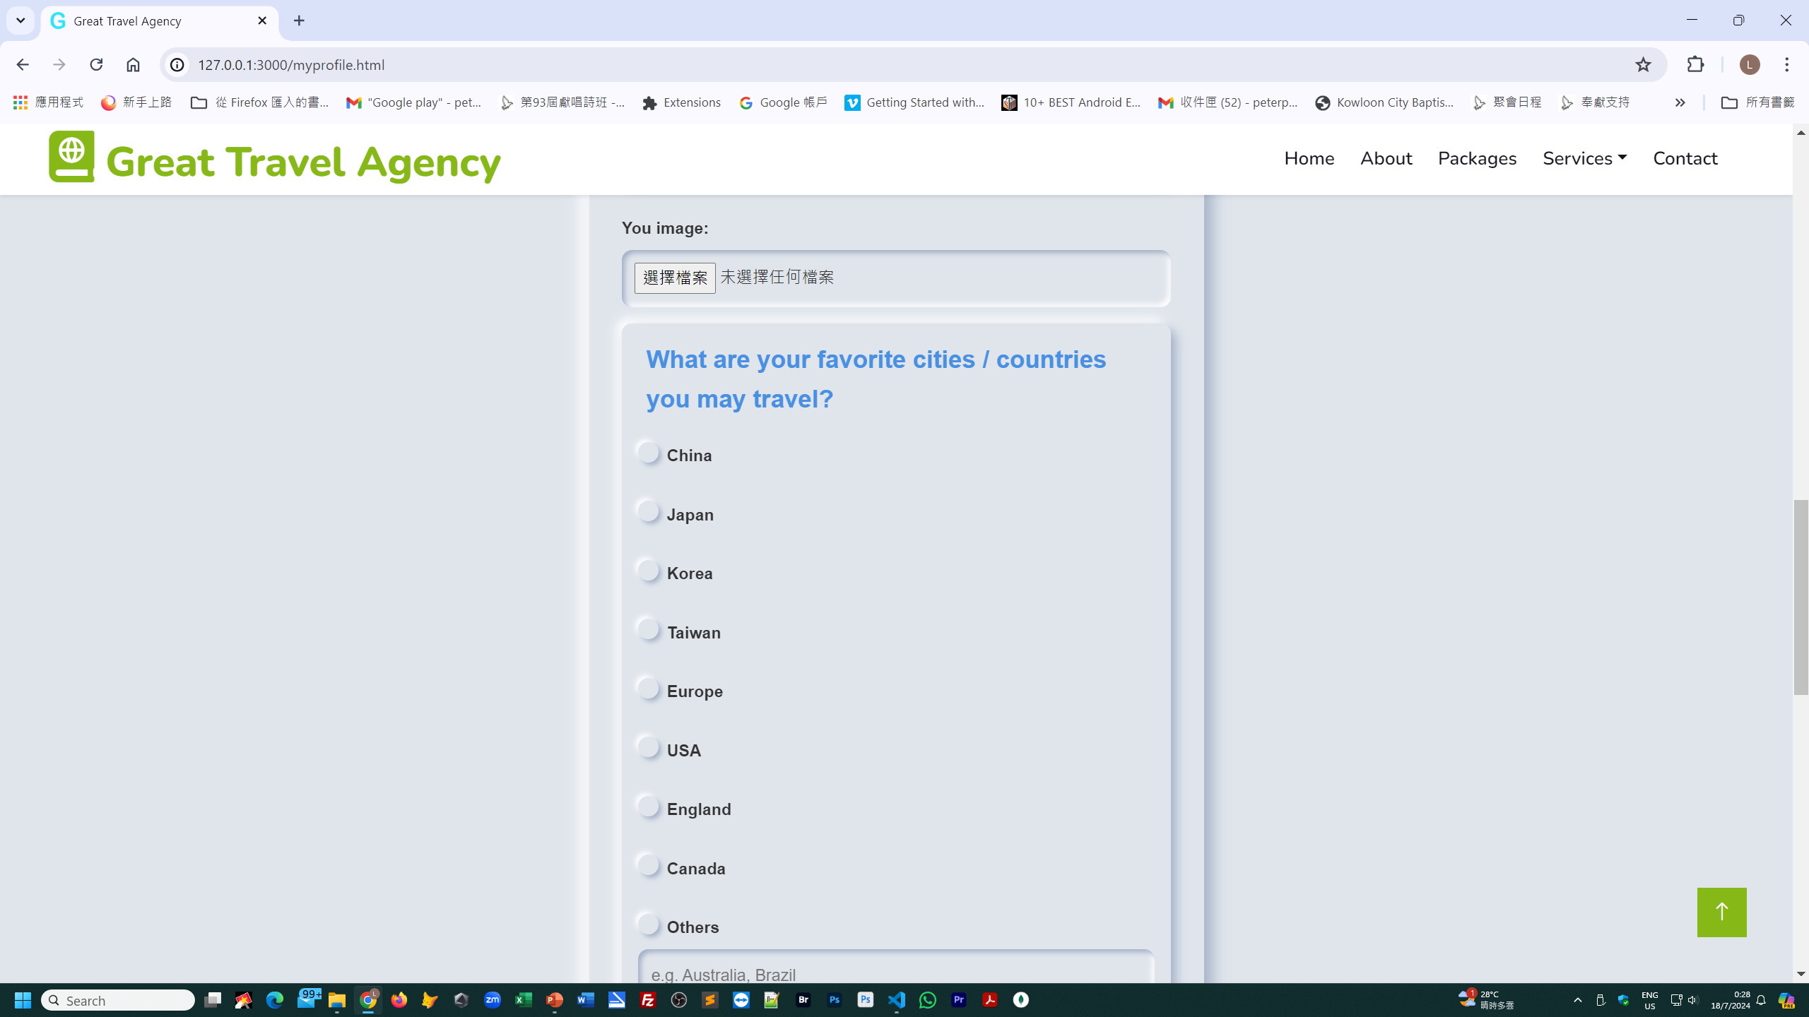

Slide 10
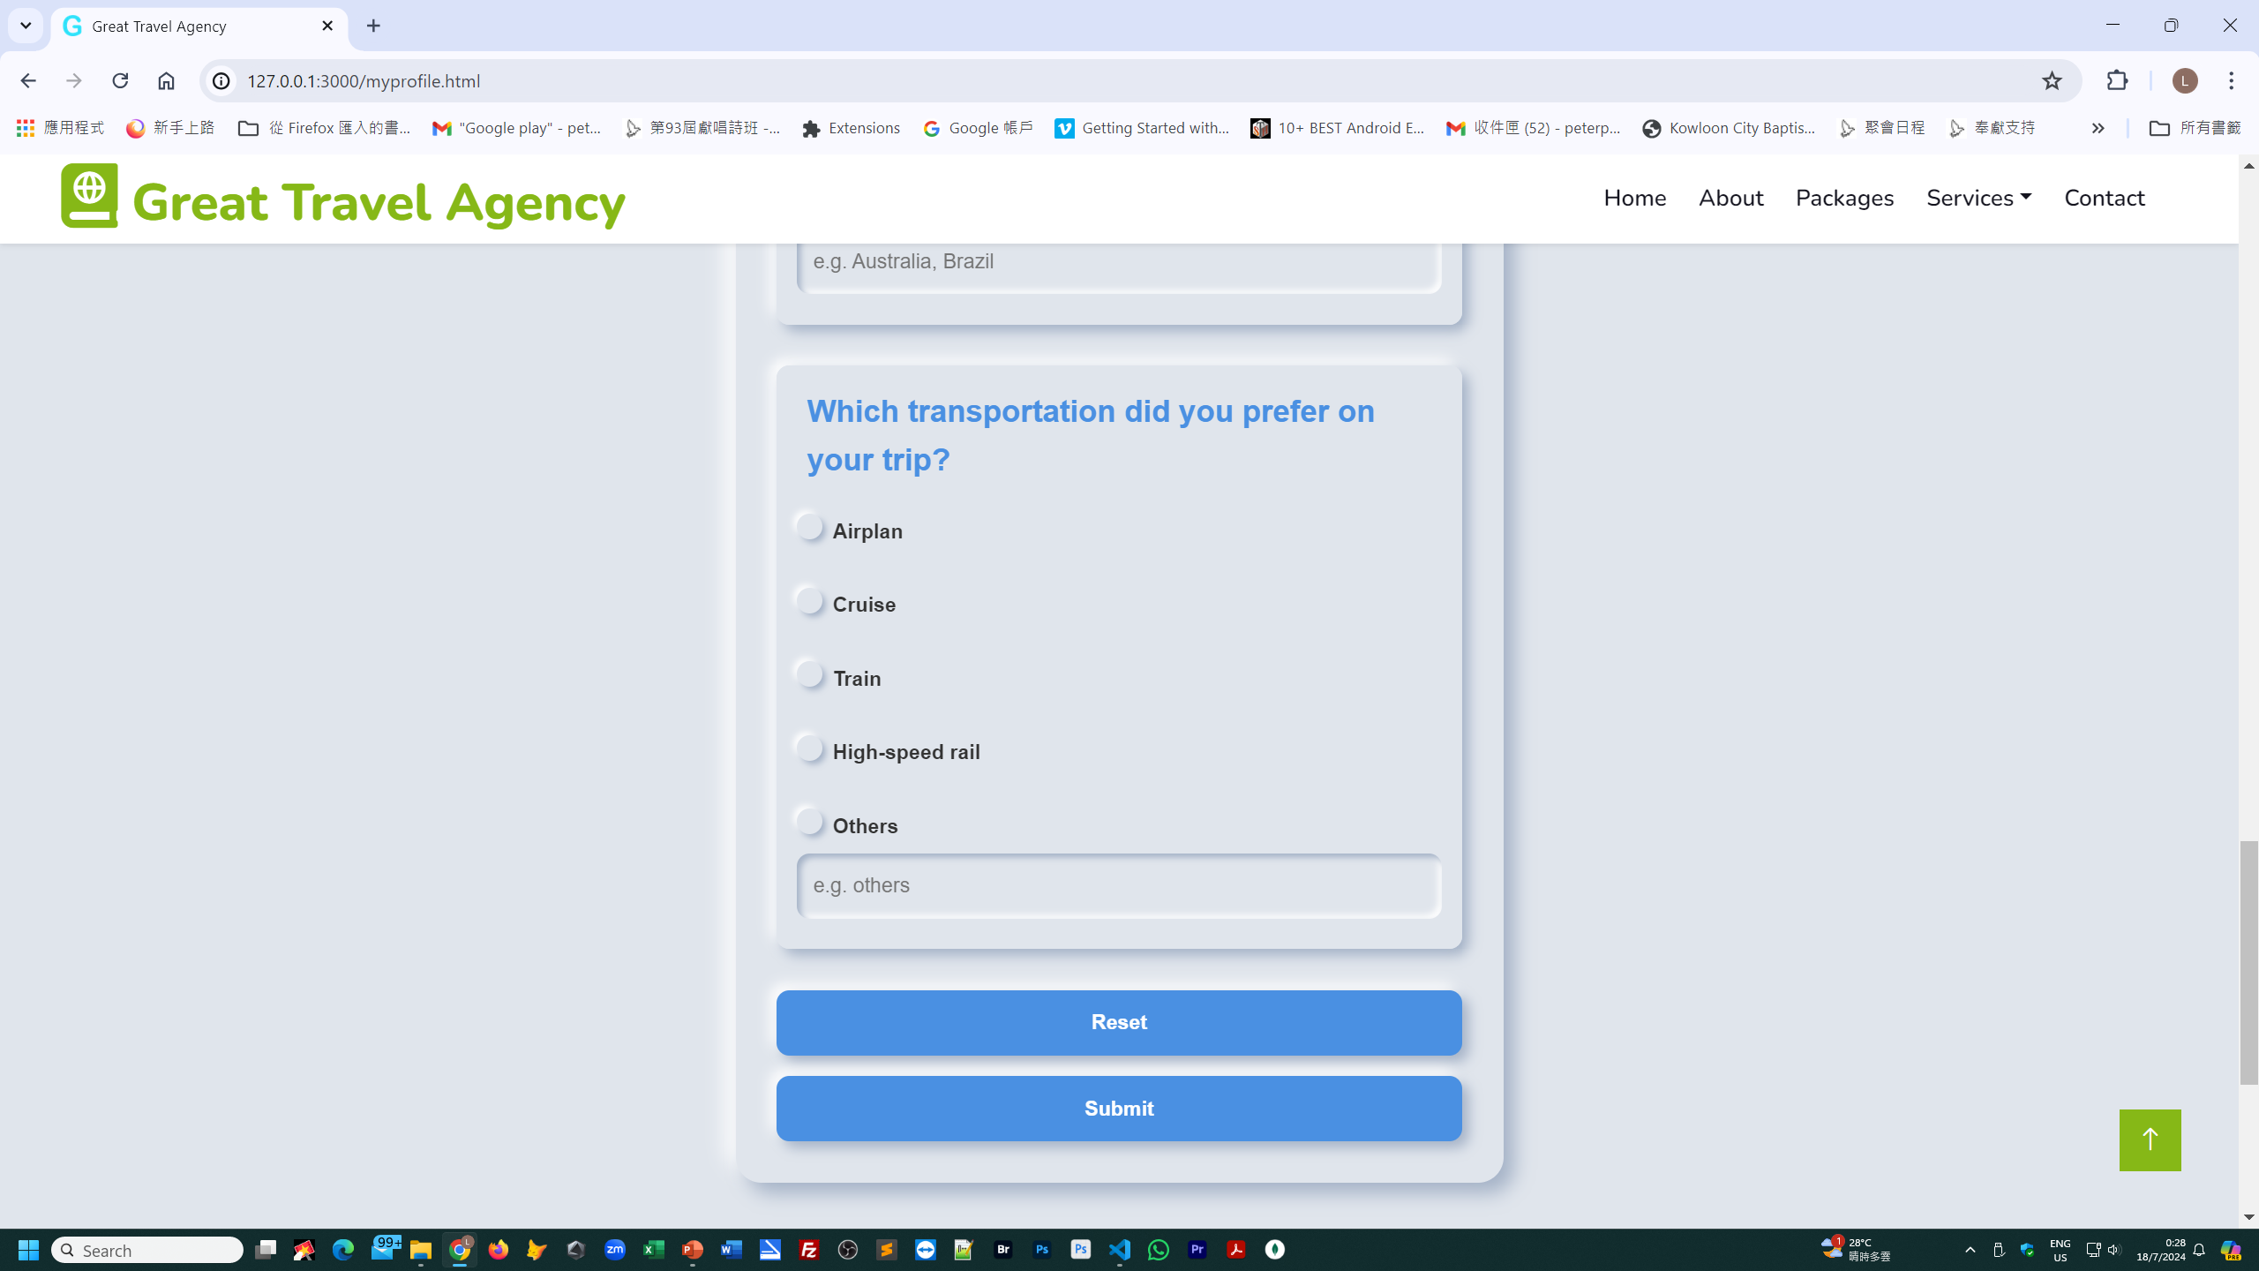

Slide 11
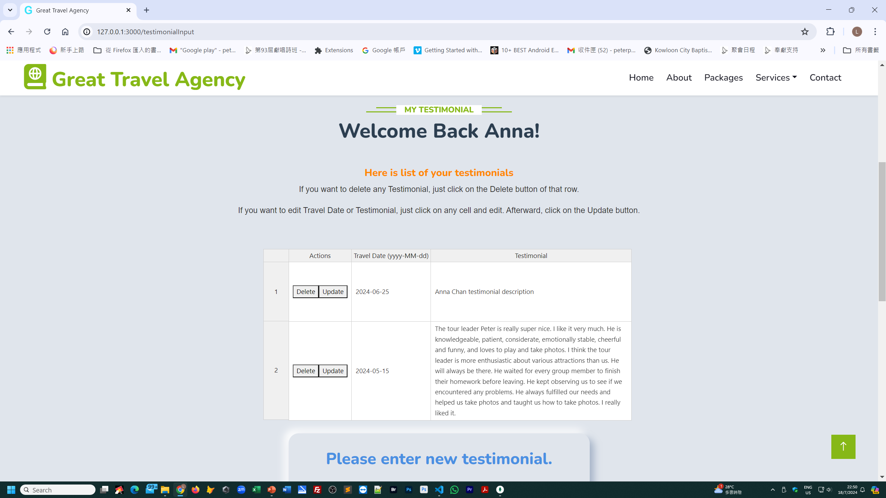

Slide 12
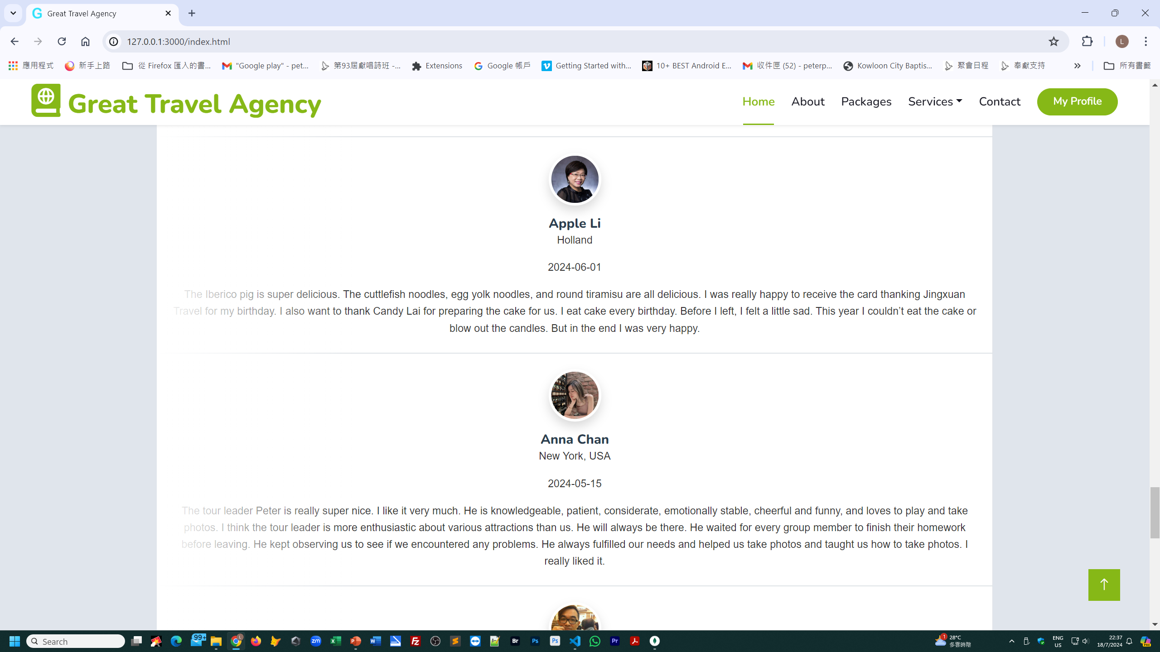

Slide 13
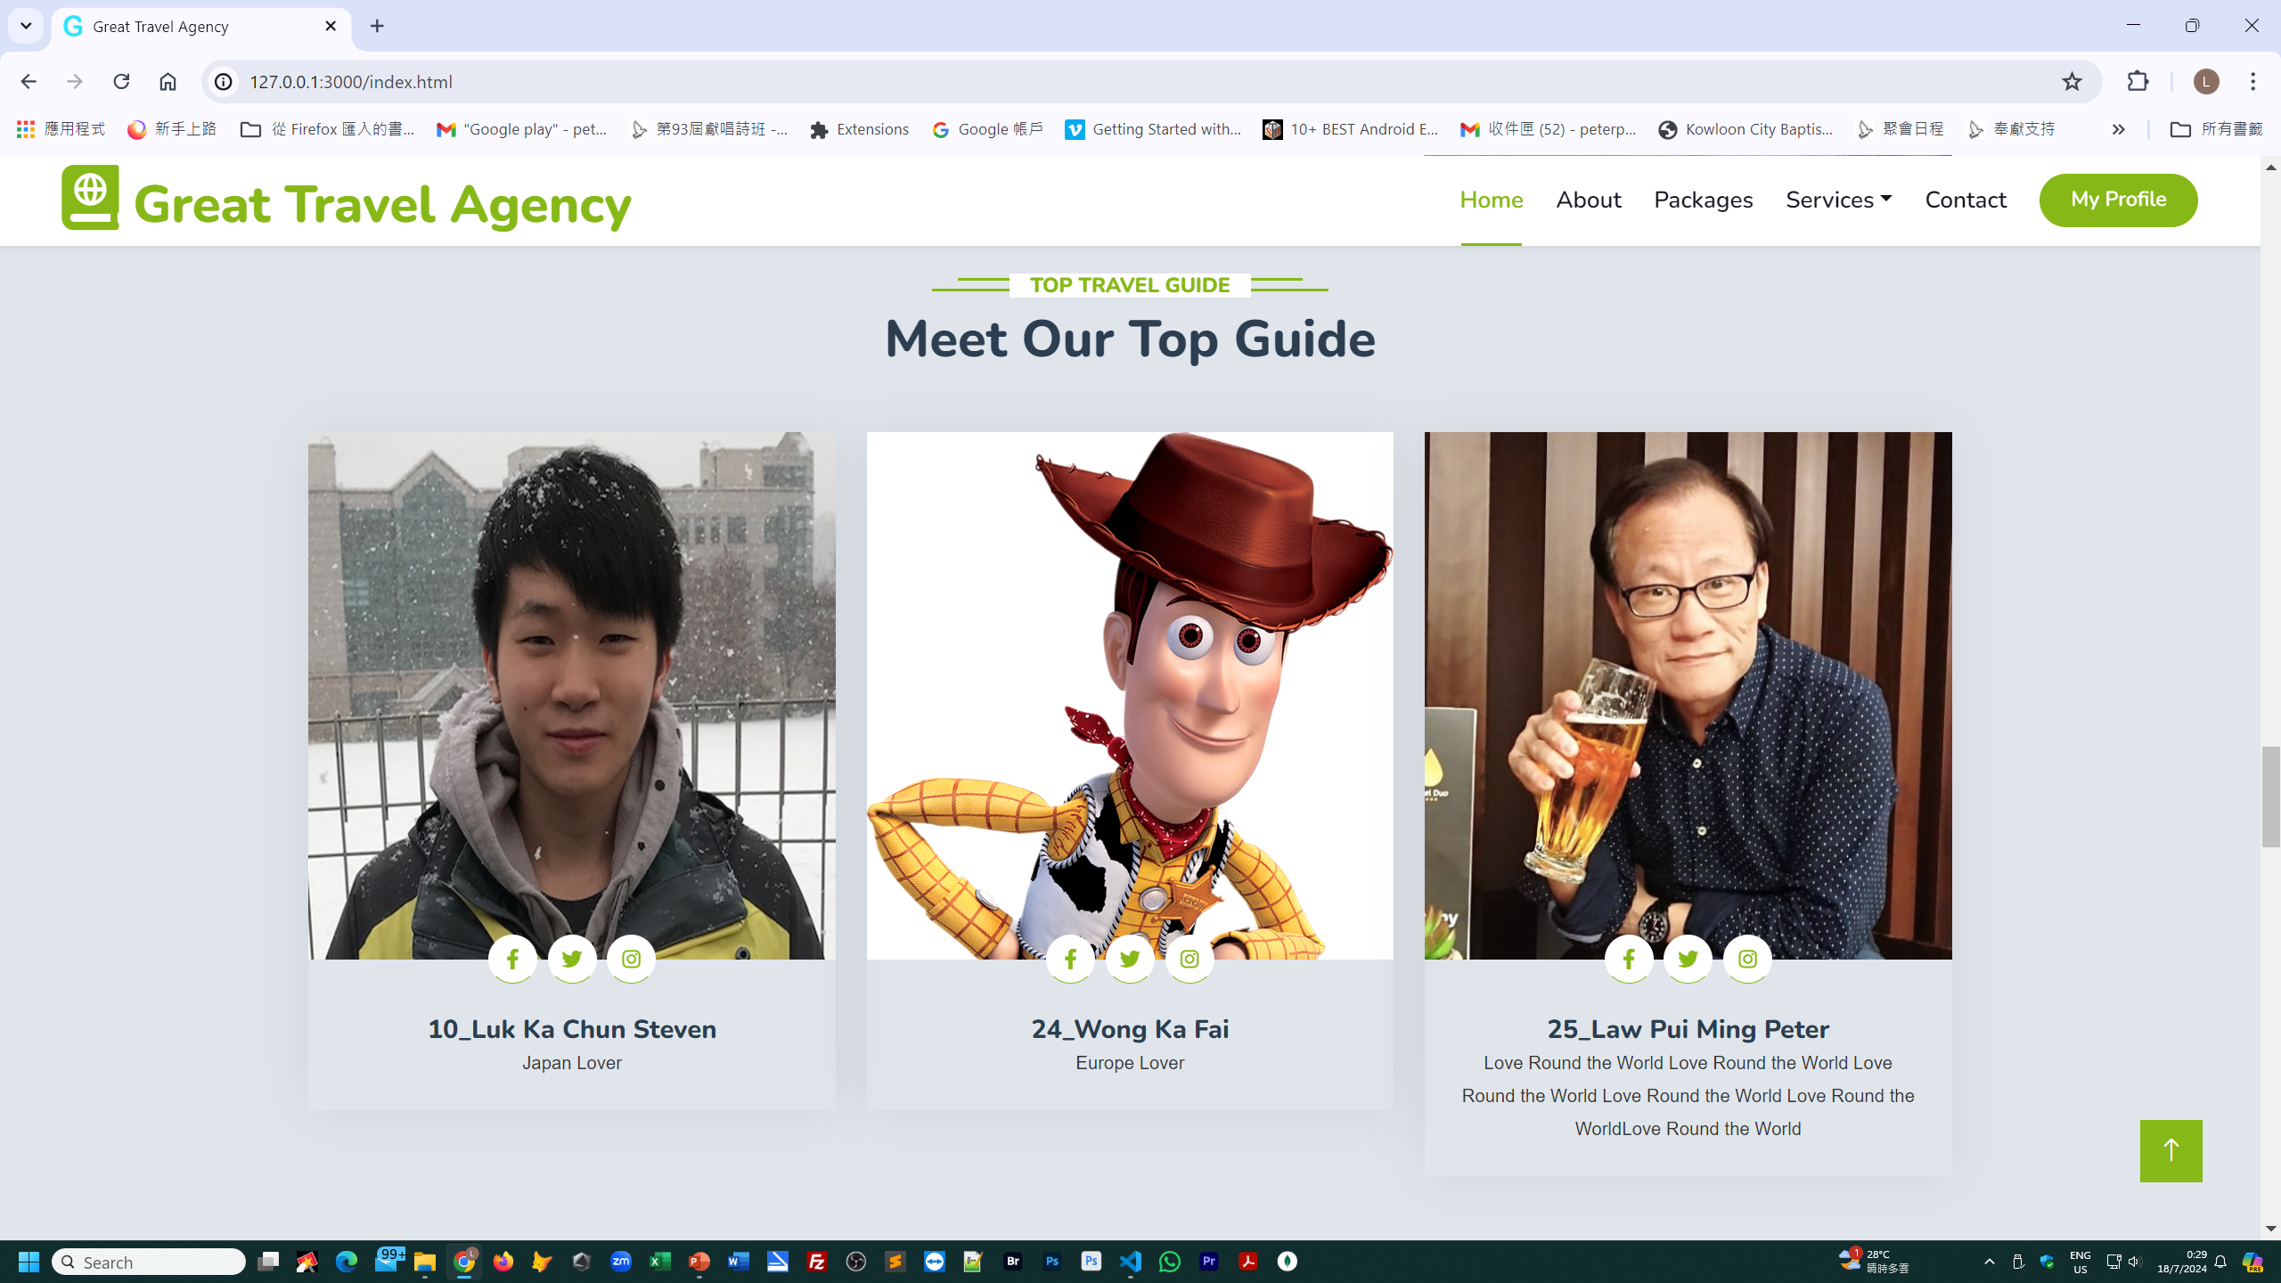

Slide 14
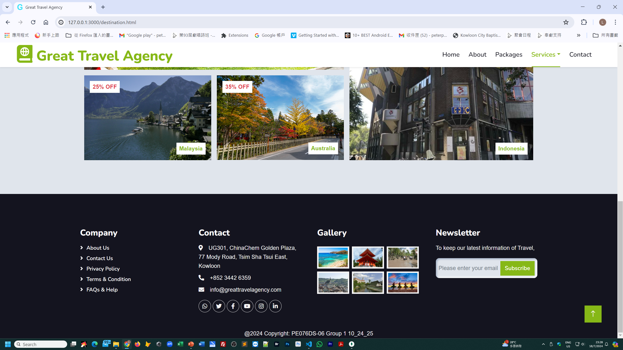

Slide 15
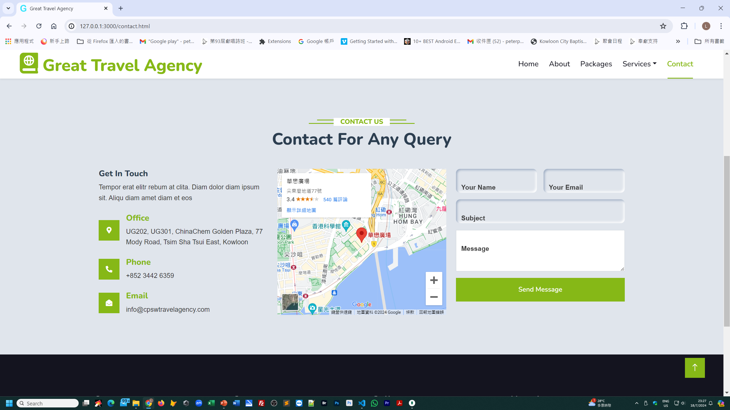

Slide 16
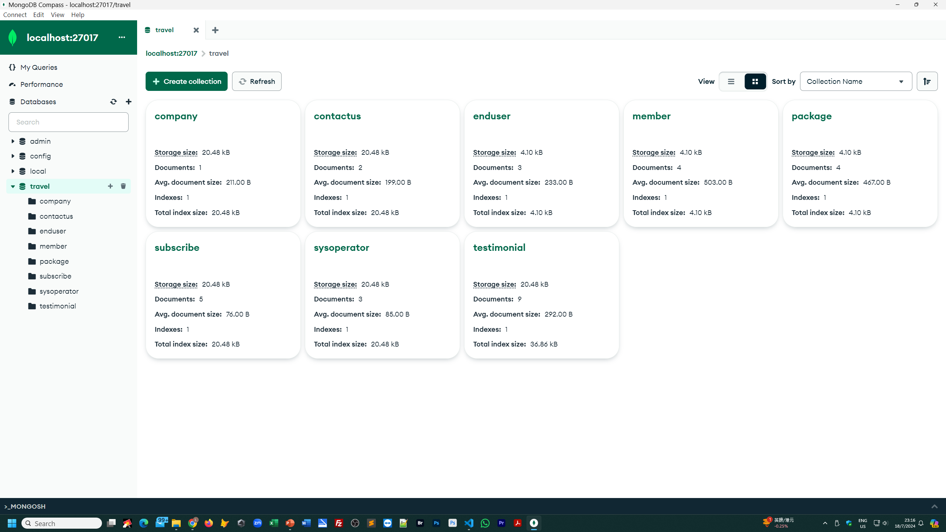
MongoDB

Slide 17
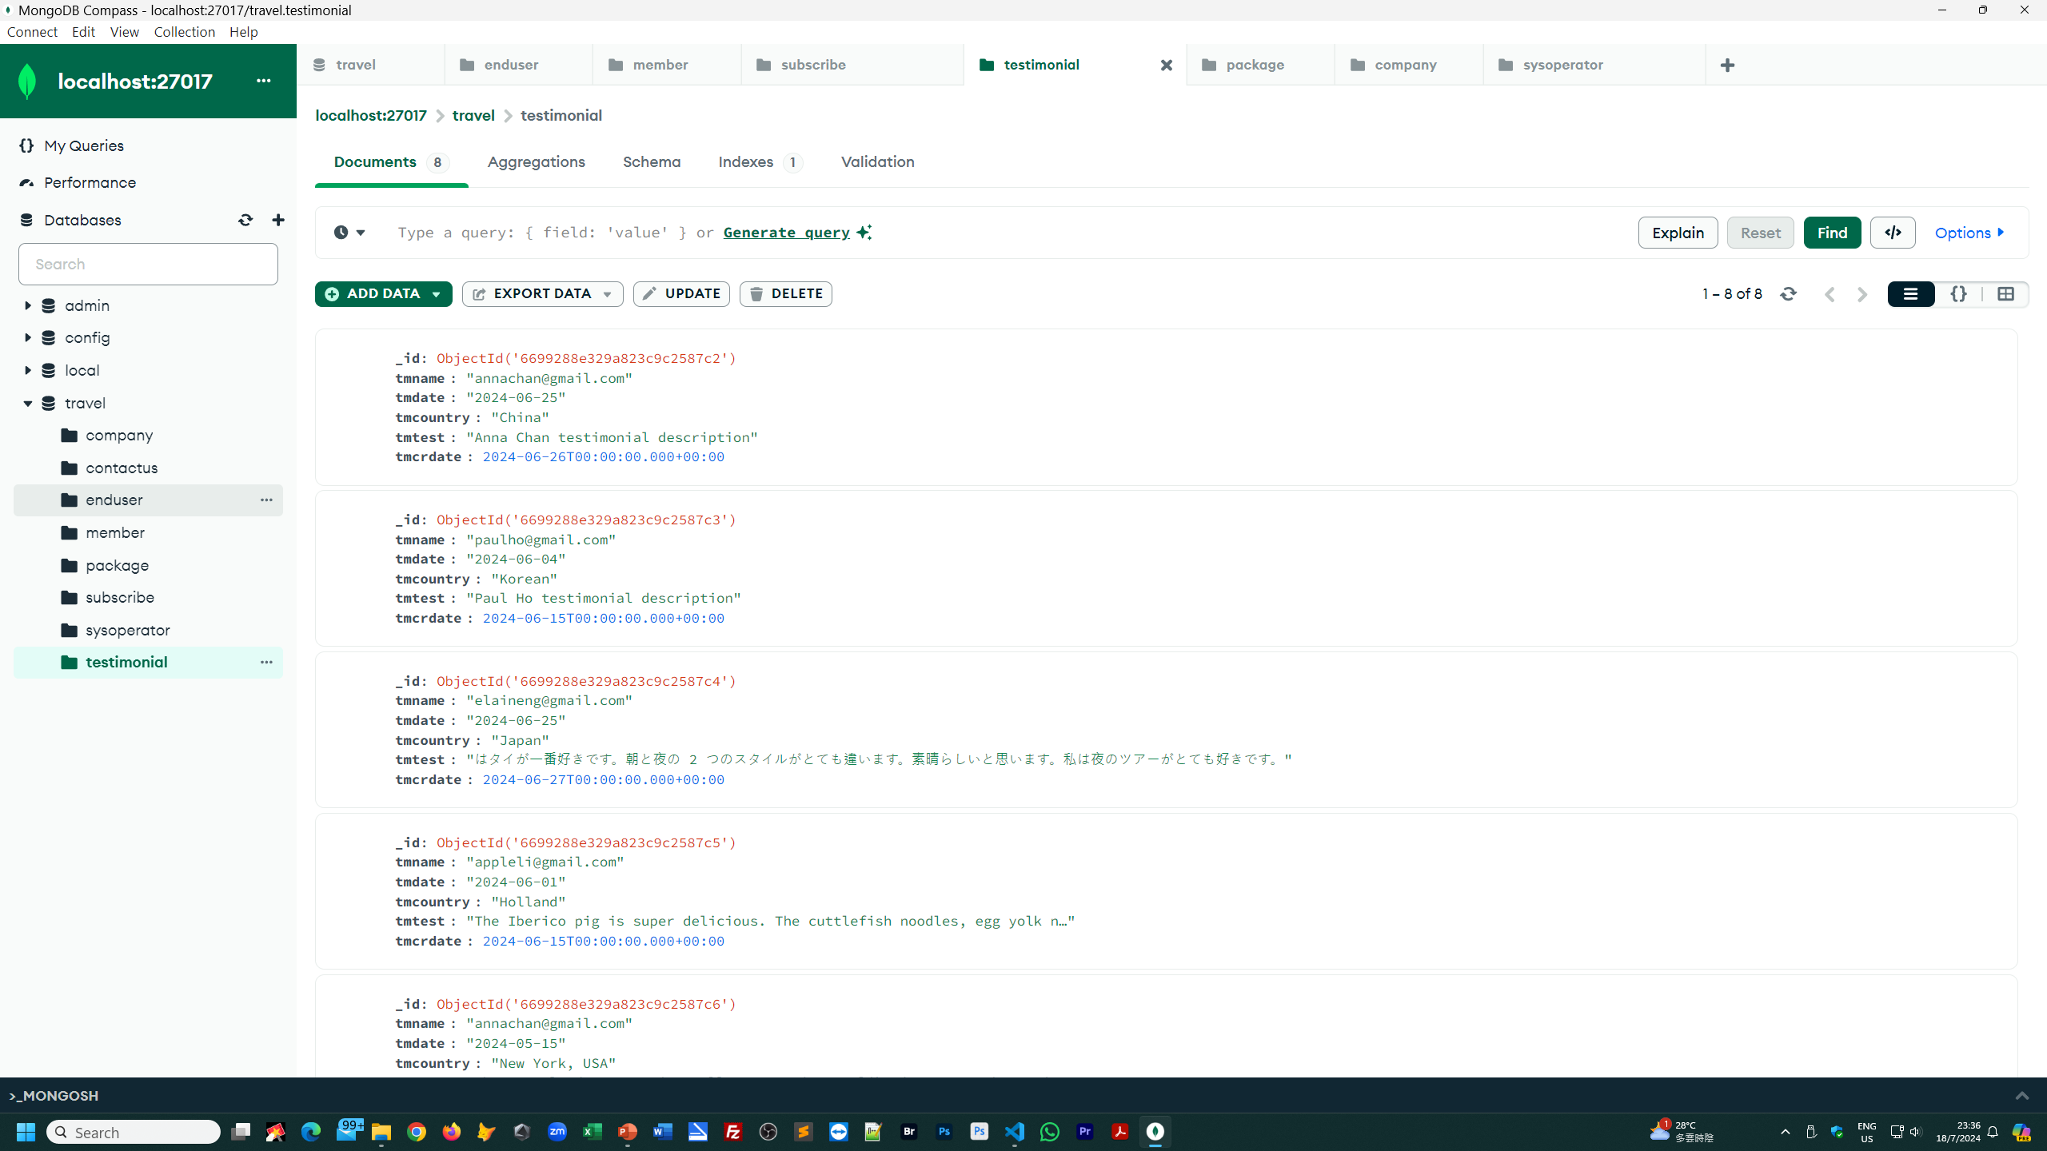

Slide 18
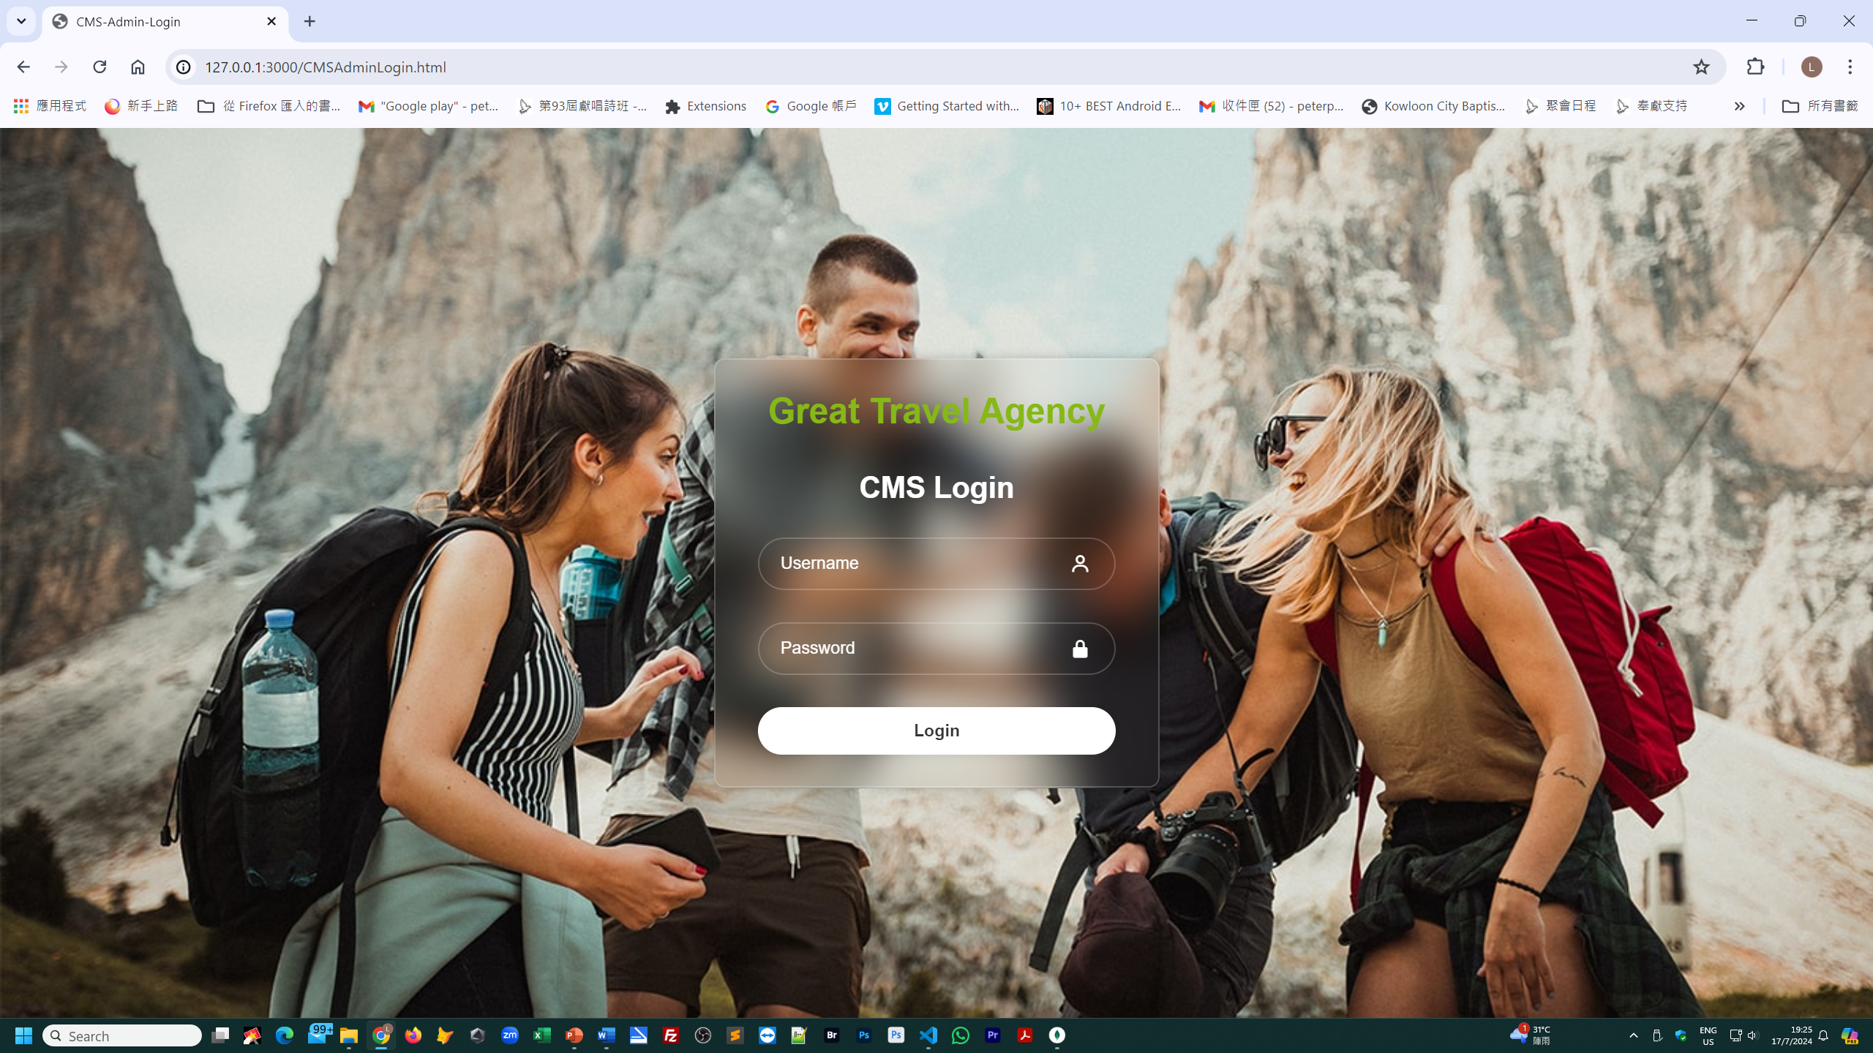
Backend

Slide 19
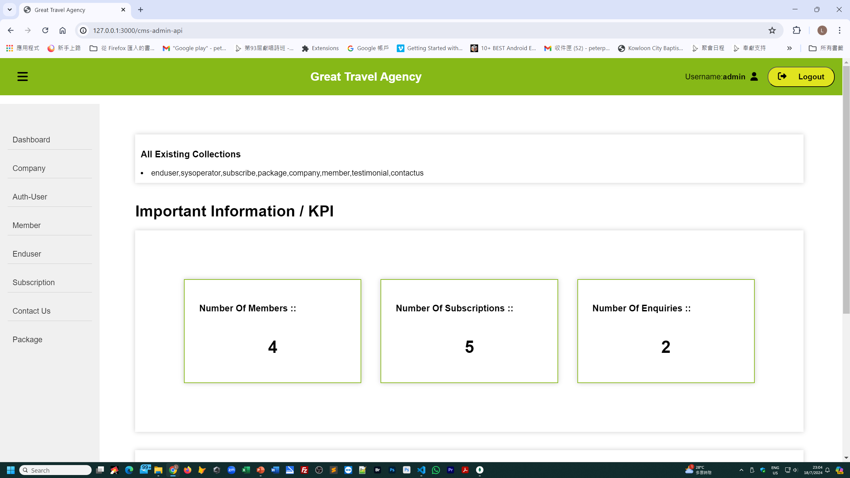
Backend CMS

Slide 20
Great Travel Agency
Web site presentation

